Slide 1


Introduction to Software Business Product Management
Week 2 Day 3
Led by: Emily Crose
for
Oakland University

Slide 2
Day 2 Recap

Slide 3

Questions From Day 2?

Slide 4
Terms To Listen For
Authentication
Refers to the process of verifying a user’s identity.
Denial of Service
A forced outage of a service based on a misconfiguration or a concerted effort

Slide 5

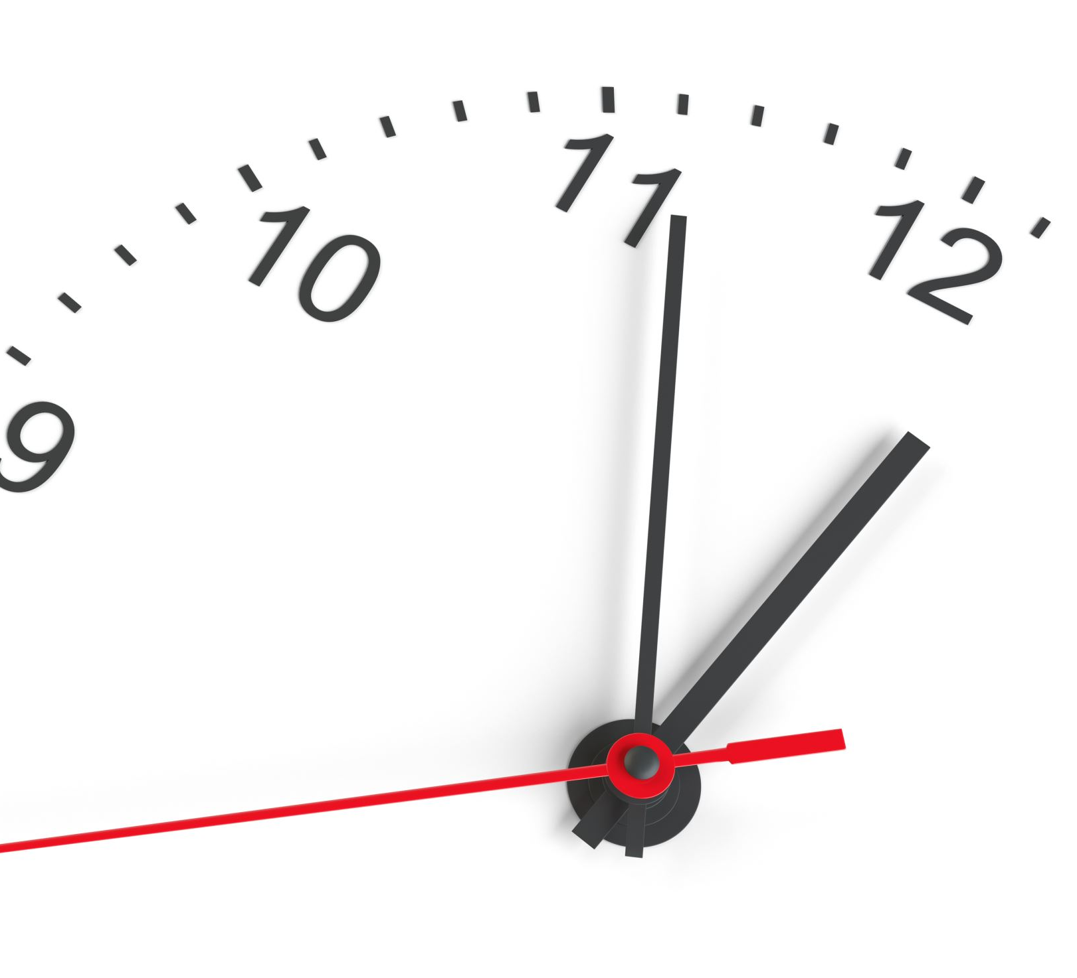
10 minute break

Slide 6
Application Programming Interfaces (APIs)
What do they do for applications?
When would we want to use an API?

Slide 7
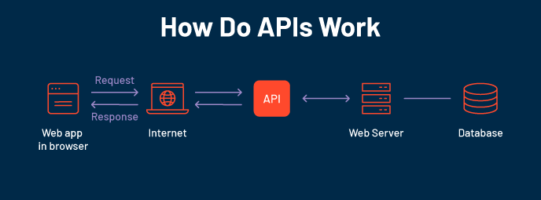

Slide 8
Familiar APIs
Representational State Transfer (REST or RESTful) API
Fast
Reliable
Widely adopted
Simple!
Simple Object Access Protocol (SOAP)
Used in some OT network appliances
Browser API
iOS/Android API
Allows developers the tools they need to utilize local resources in their own programs
Notification API calls
Camera activation
Media integration

Slide 9
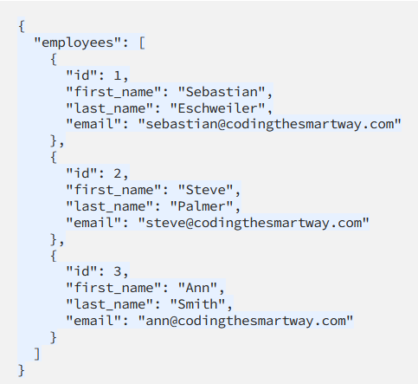
Notes:
Let’s take a look at a JSON form providing us information through an API interface. So when we use an API to retrieve information, we will typically be grabbing that information from a formatted file like a JSON file. We can see from this JSON file that actually this looks kind of like a database file.

Slide 10
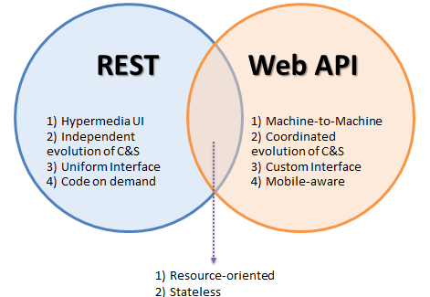
Popular API Frameworks

Slide 11
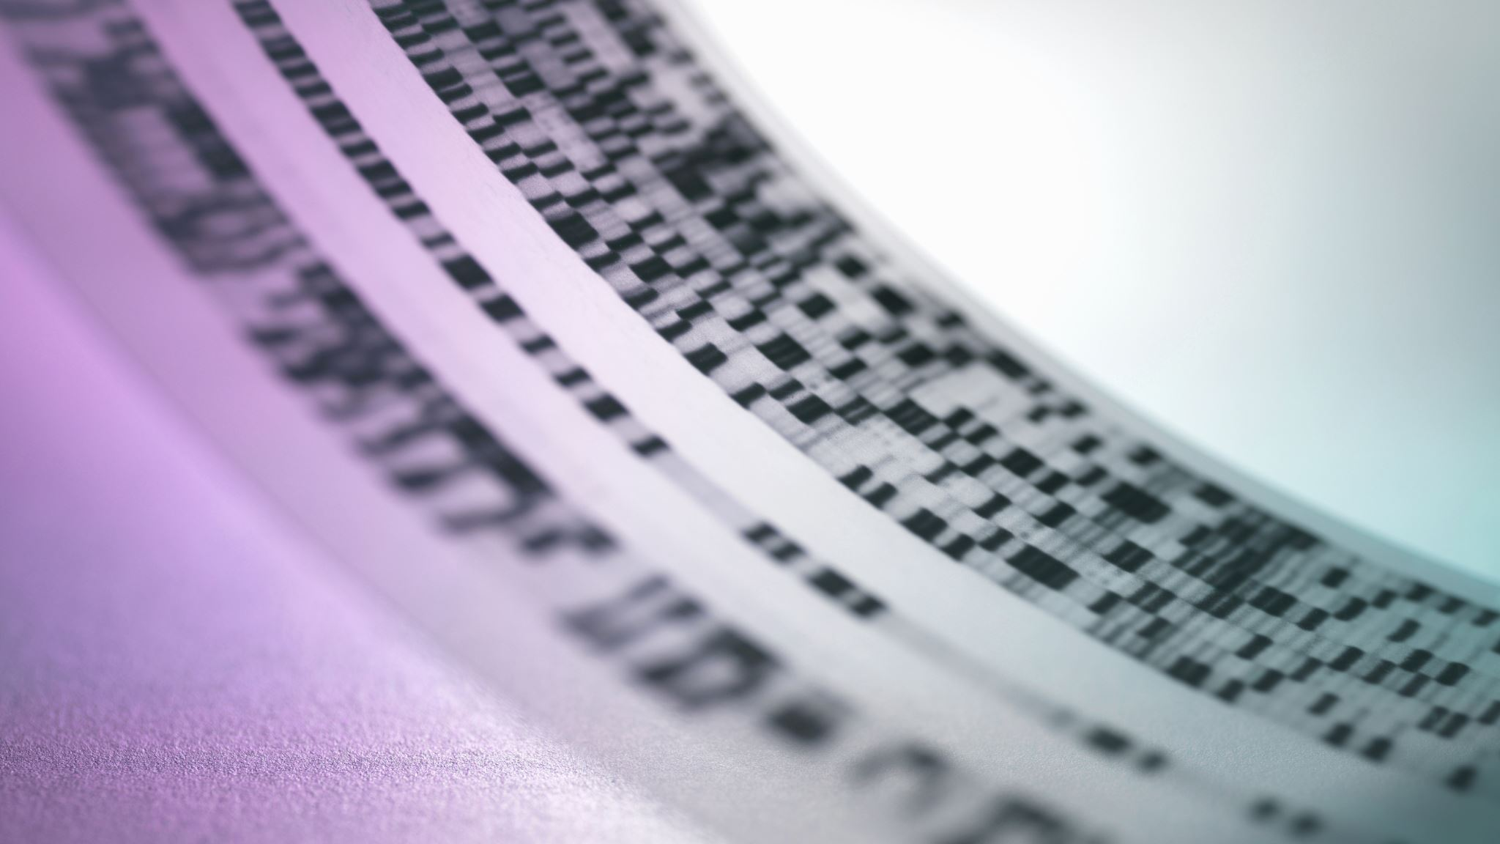
HTTP/Web API

Slide 12
HTTP API Verbs
HTTP
GET
POST
PUT
DELETE

Slide 13
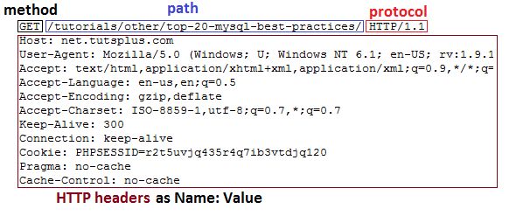
HTTP GET Header

Slide 14
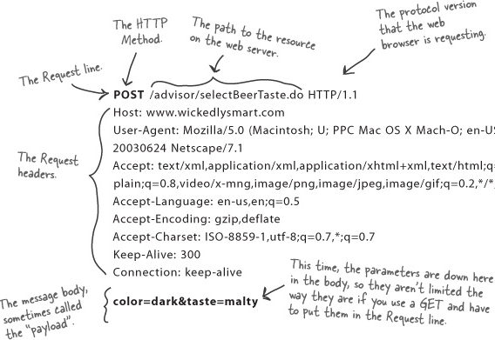
HTTP POST Header

Slide 15
Weather API Documentation
https://rapidapi.com/weatherapi/api/weatherapi-com
Notes:
A word on documentation – we should always start with the documentation when we go to program with an API

Slide 16
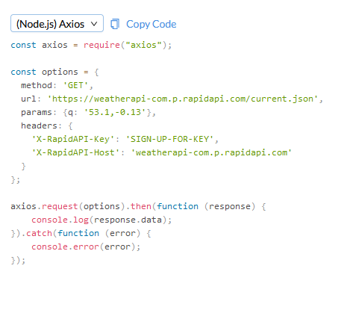
Notes:
So let’s take a look at what an API actually looks like in practice.

Slide 17
Working With APIs
Can be programmed
Can be used in a raw request

Slide 18
Programming Mobile Apps w/APIs
Android
Kotlin
Apple iOS
SWIFT
Both have access to device APIs!

Slide 19

Mobile Device API Example

Slide 20
10 minute break

Slide 21


Securing APIs

Slide 22
SAML vs. Oauth
Security Assertion Markup Language (SAML)
Windows uses this for Single Sign On (SSO)
Integrates with Windows domain
Optimized for enterprise security
Oauth
Optimized for mobile applications
Uses API calls itself!
Tends to play better with mobile & lightweight IoT environments

Slide 23

What is Oauth?

Slide 24
Oauth
Allows one application to validate itself with another application
Uses tokens for authentication
We give applications permission to play with other applications via Oauth
Think of it like a valet for your apps!

Slide 25
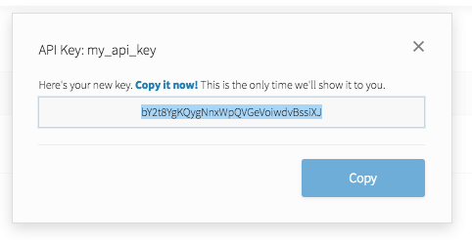
API Key
Notes:
API keys are meant to be kept secret. Why? Because they include information related to one specific account.

Slide 26

Why Do We Need API Keys?
Account verification
Who is requesting what information?
Rate limiting
Avoid denial of service
Permissions
What do we want to allow certain people to see?

Slide 27
How does OAuth work?

Slide 28
Let’s Make A Github Account!
https://github.com

Slide 29

Software Development: The Lifecycle

Slide 30
What is the Software Development Life Cycle?
The SDLC helps us organize the process of building software
Includes steps for building, revising, and deploying software
Includes roles associated with each step along the building process

Slide 31
Why Do We Need An SDLC?
Notes:
We’ve spent two full weeks talking about how software functions, how software can go wrong, and some about how we build software. So by now, it should be obvious that software development is a fairly complicated subject. What we need is a notional concept to fit all of the components of software development into if for no other reason than organization.
For each of the functions of the process of building software, we will have multiple groups with multiple people all working together to create functional applications. This means we have a lot of moving human parts which can be challenging to successfully navigate without a common understanding.

Slide 32
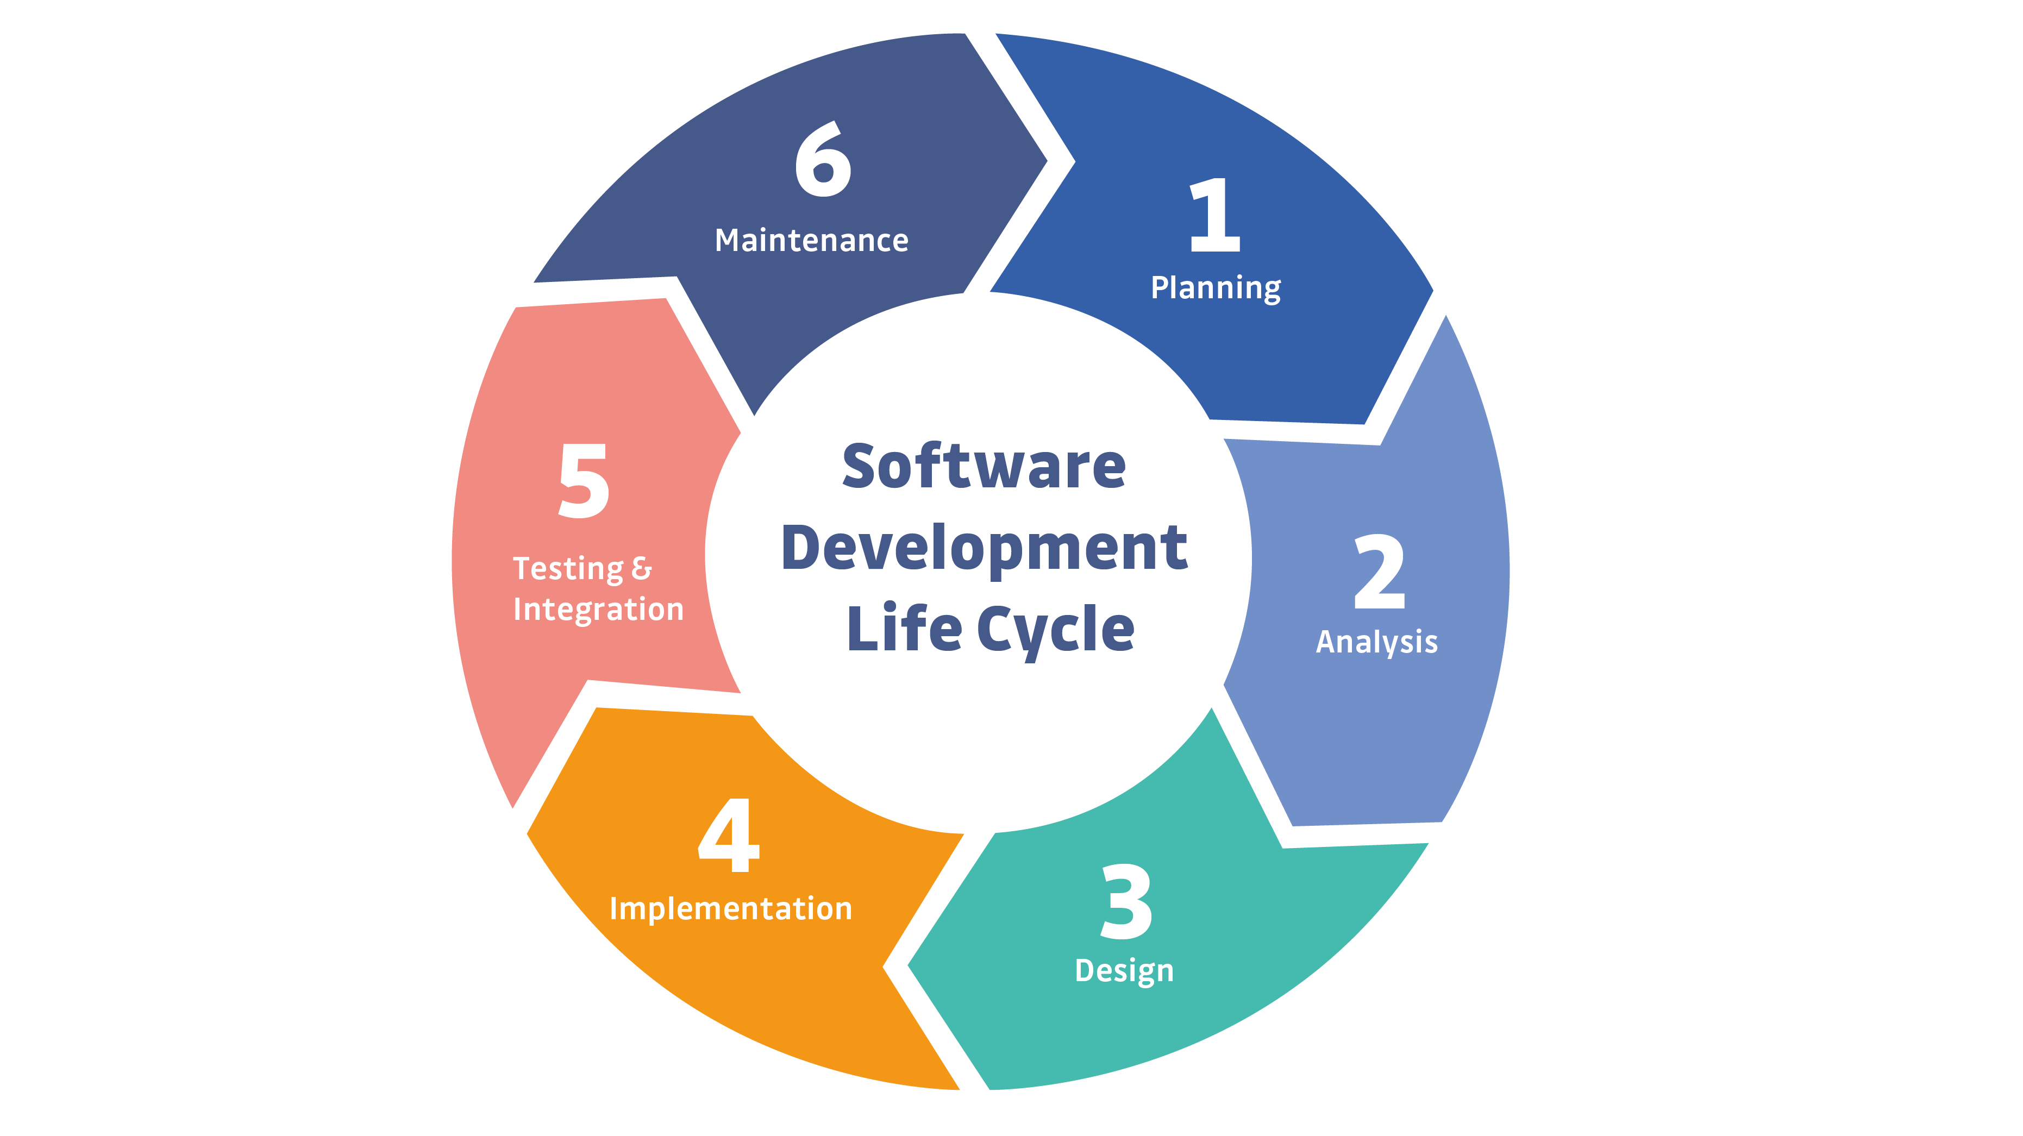
Notes:
This is a simple example of the SDLC. Typically, representations of the SDLC will have around 6 steps, but the steps will generally match what you see here.

Slide 33

More To Come on the SDLC Next Time!

Slide 34

Question or clarifications?

Slide 35

Review Day 3

Slide 36

Preview Week 3

